Slide 1
Data and AI: Birds of a Feather
MLOps
Azure Machine Learning + Azure Pipelines + GitHub + VScode = Fun

Slide 2
Agenda
What is MLOps?
Why consider an MLOps approach
Azure MLOps Reference Architecture
Zooming into the Azure DevOps Build pipeline
Zooming into the Azure Machine Learning training/retraining Pipelines
Zooming into the Azure DevOps Release pipeline
Q&A

Slide 3
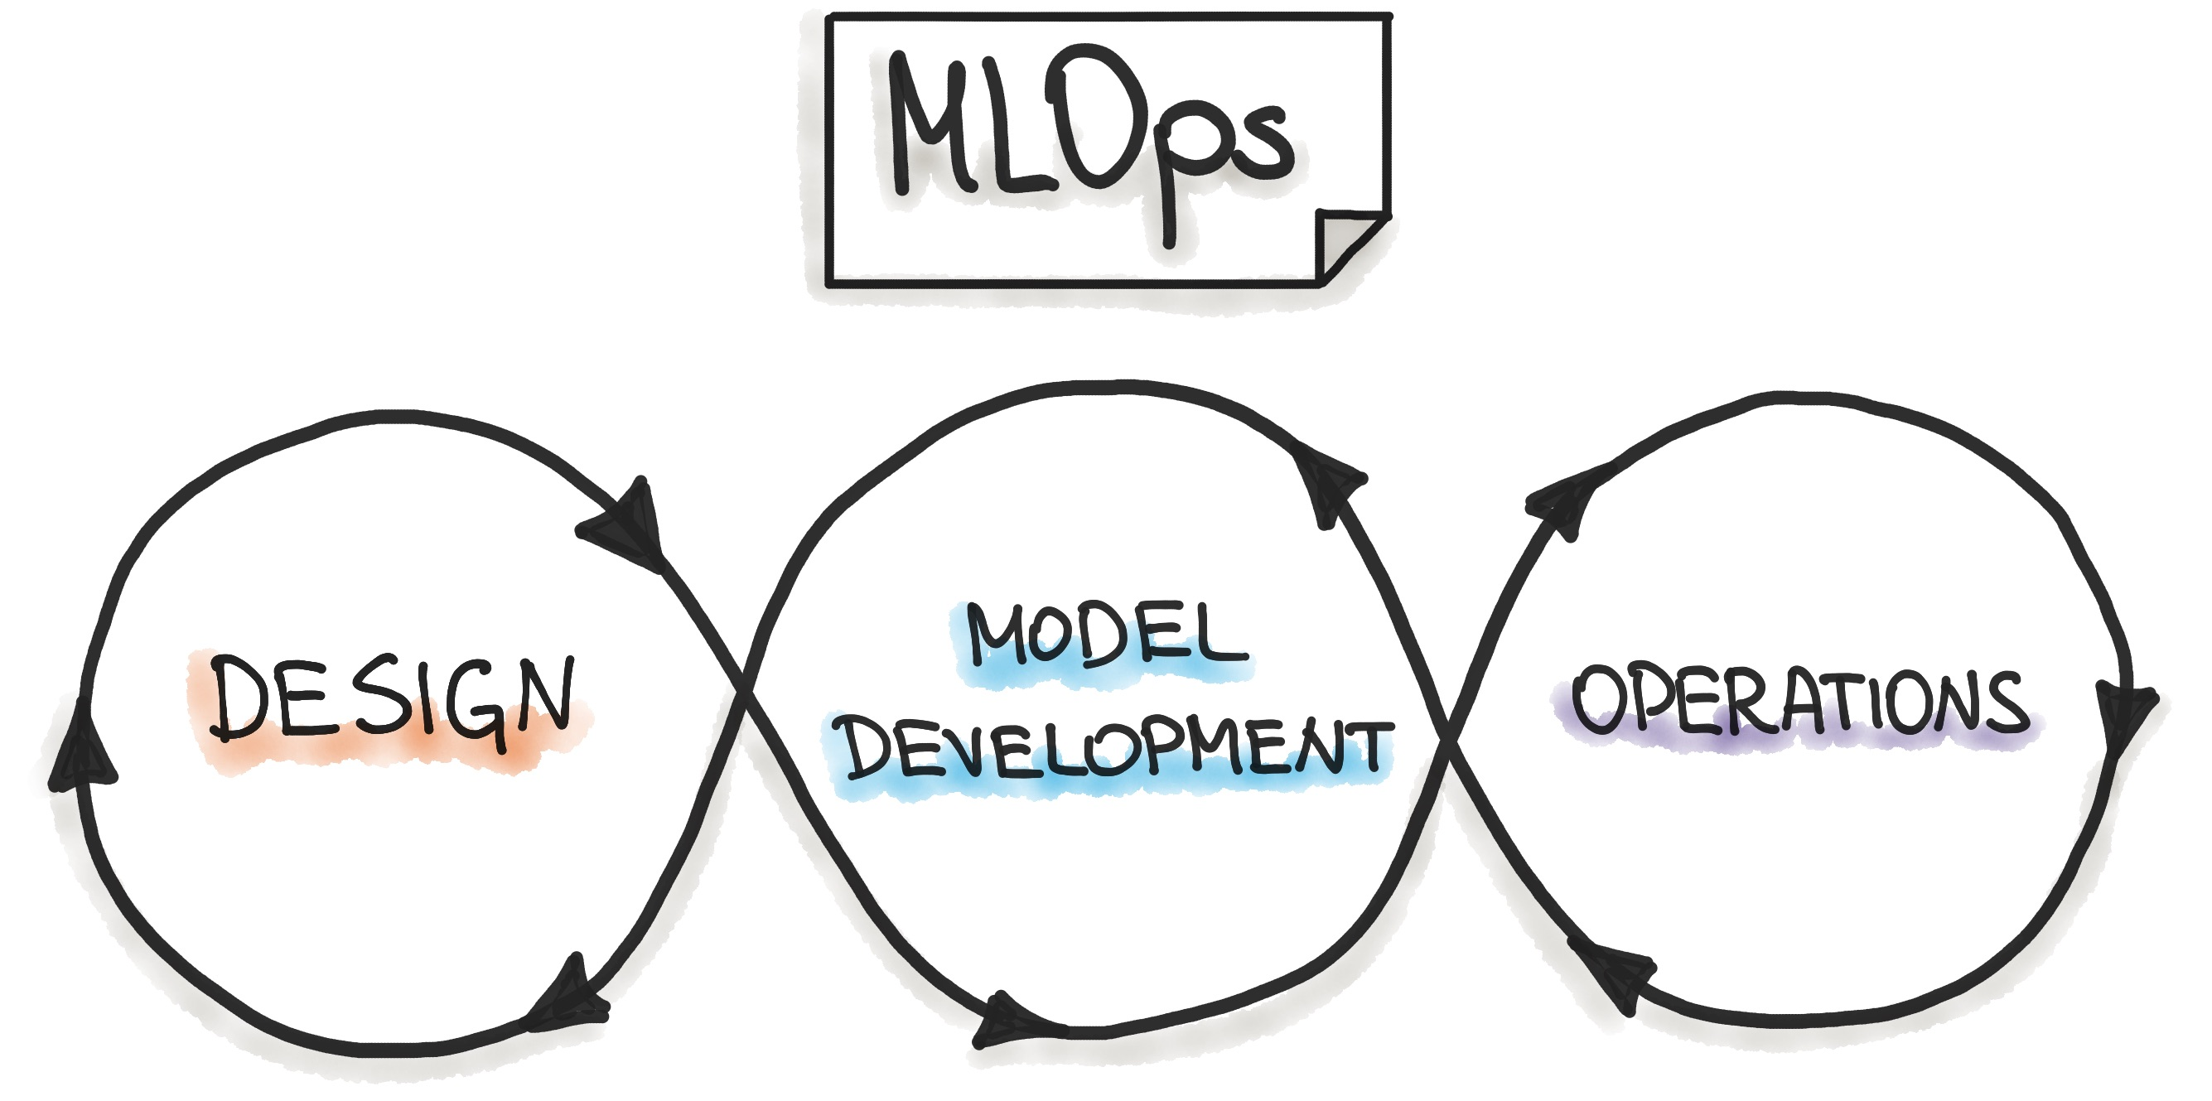
What is MLOps?
The term MLOps is defined as “the extension of the DevOps methodology to include Machine Learning and Data Science assets as first-class citizens within the DevOps ecology” Source: MLOps SIG.
Alternatively, we can use the definition of Machine Learning Engineering (MLE), where MLE is the use of scientific principles, tools, and techniques of machine learning and traditional software engineering to design and build complex computing systems. MLE encompasses all stages from data collection, to model building, to make the model available for use by the product or the consumers.” (by A.Burkov).
MLOps, like DevOps, emerges from the understanding that separating the ML model development from the process that delivers it — ML operations — lowers quality, transparency, and agility of the whole intelligent software.
This Photo by Unknown Author is licensed under CC BY

Slide 4
What is MLOps?
Testing: Like in DevOps, a crucial part of software development and machine learning is not left out. MLOps provides a structured testing technique for machine learning systems based on the development pipeline's three essential components: data pipeline, ML model pipeline, and the application pipeline. The integration and usability of each feature are tested to ensure the reliability of the ML model.
Monitoring: Like testing, monitoring the ML model periodically when deployed is important and verified by this principle. To ensure that the model performs as expected, the dependency, data version, usage, and change made to the model are monitored. The model's desired behaviors should be pre-recorded and used as a benchmark which when the model underperforms or spikes irregularly, necessary actions are taken.
Versioning: Versioning ensures that every change made to the machine learning model's data sets and code base is tracked using a version control system. Considering that a significant number of events can bring about changes in data or cause an anomaly in a machine learning model, different versions of the model are tracked and saved by the version control tool. This makes it easy to revert to a previous version or know exactly where a bug is fixed when a problem arises.
Continuous “Everything”: One of the beauties of DevOps that is adopted in MLOps is the continuous workflow in the ML pipeline. Machine learning models are temporary and subject to change based on their use cases as soon as new data are available. MLOps allows for easy implementation of the ML engineering processes including continuous integration (CI), continuous delivery (CD), continuous testing (CT), and continuous monitoring (CM).
Automation: Automation should be prioritized to implement MLOps in your machine learning project successfully. The level of automation of your ML model determines your ML process's maturity, which in turn increases the speed at which machine learning models can be trained, developed, and deployed. This principle encourages an entirely automated ML workflow without a need for human interaction, with notable events used as triggers for each workflow process. Embracing automation with MLOps happens in three stages.

Slide 5
Why consider an MLOps approach
Collaboration
When we look at the traditional setting of all teams working on an ML project, the software development, data science, and IT operations teams, we see an uncorrelated and isolated group of individuals with different expertise. MLOps bings a more collaborative process that makes all teams work hand-in-hand to combine their expertise in building more efficient, fast, and scalable machine learning models that leverage all fields.
Automation
The benefits of automation in software and machine learning development are very crucial to achieve desired business results. Rather than wasting time repeating the same processes involved in the ML-powered software's lifecycle, automation also helps various teams focus on more critical business issues to drive more fast and reliable business solutions.
Rapid Innovation
Improved collaboration and automation in machine learning by MLOps fosters rapid innovation and development of new feature-rich machine learning solutions.
Easy Deployment
MLOps makes it easy to deploy a machine learning algorithm through a streamlined process like that in DevOps. It improves the continuous integration, deployment, and delivery of machine learning models.
Effective Lifecycle Management
MLOps ultimately improves all production teams' efficiency and the entire machine learning project development workflow right from design to deployment.

Slide 6
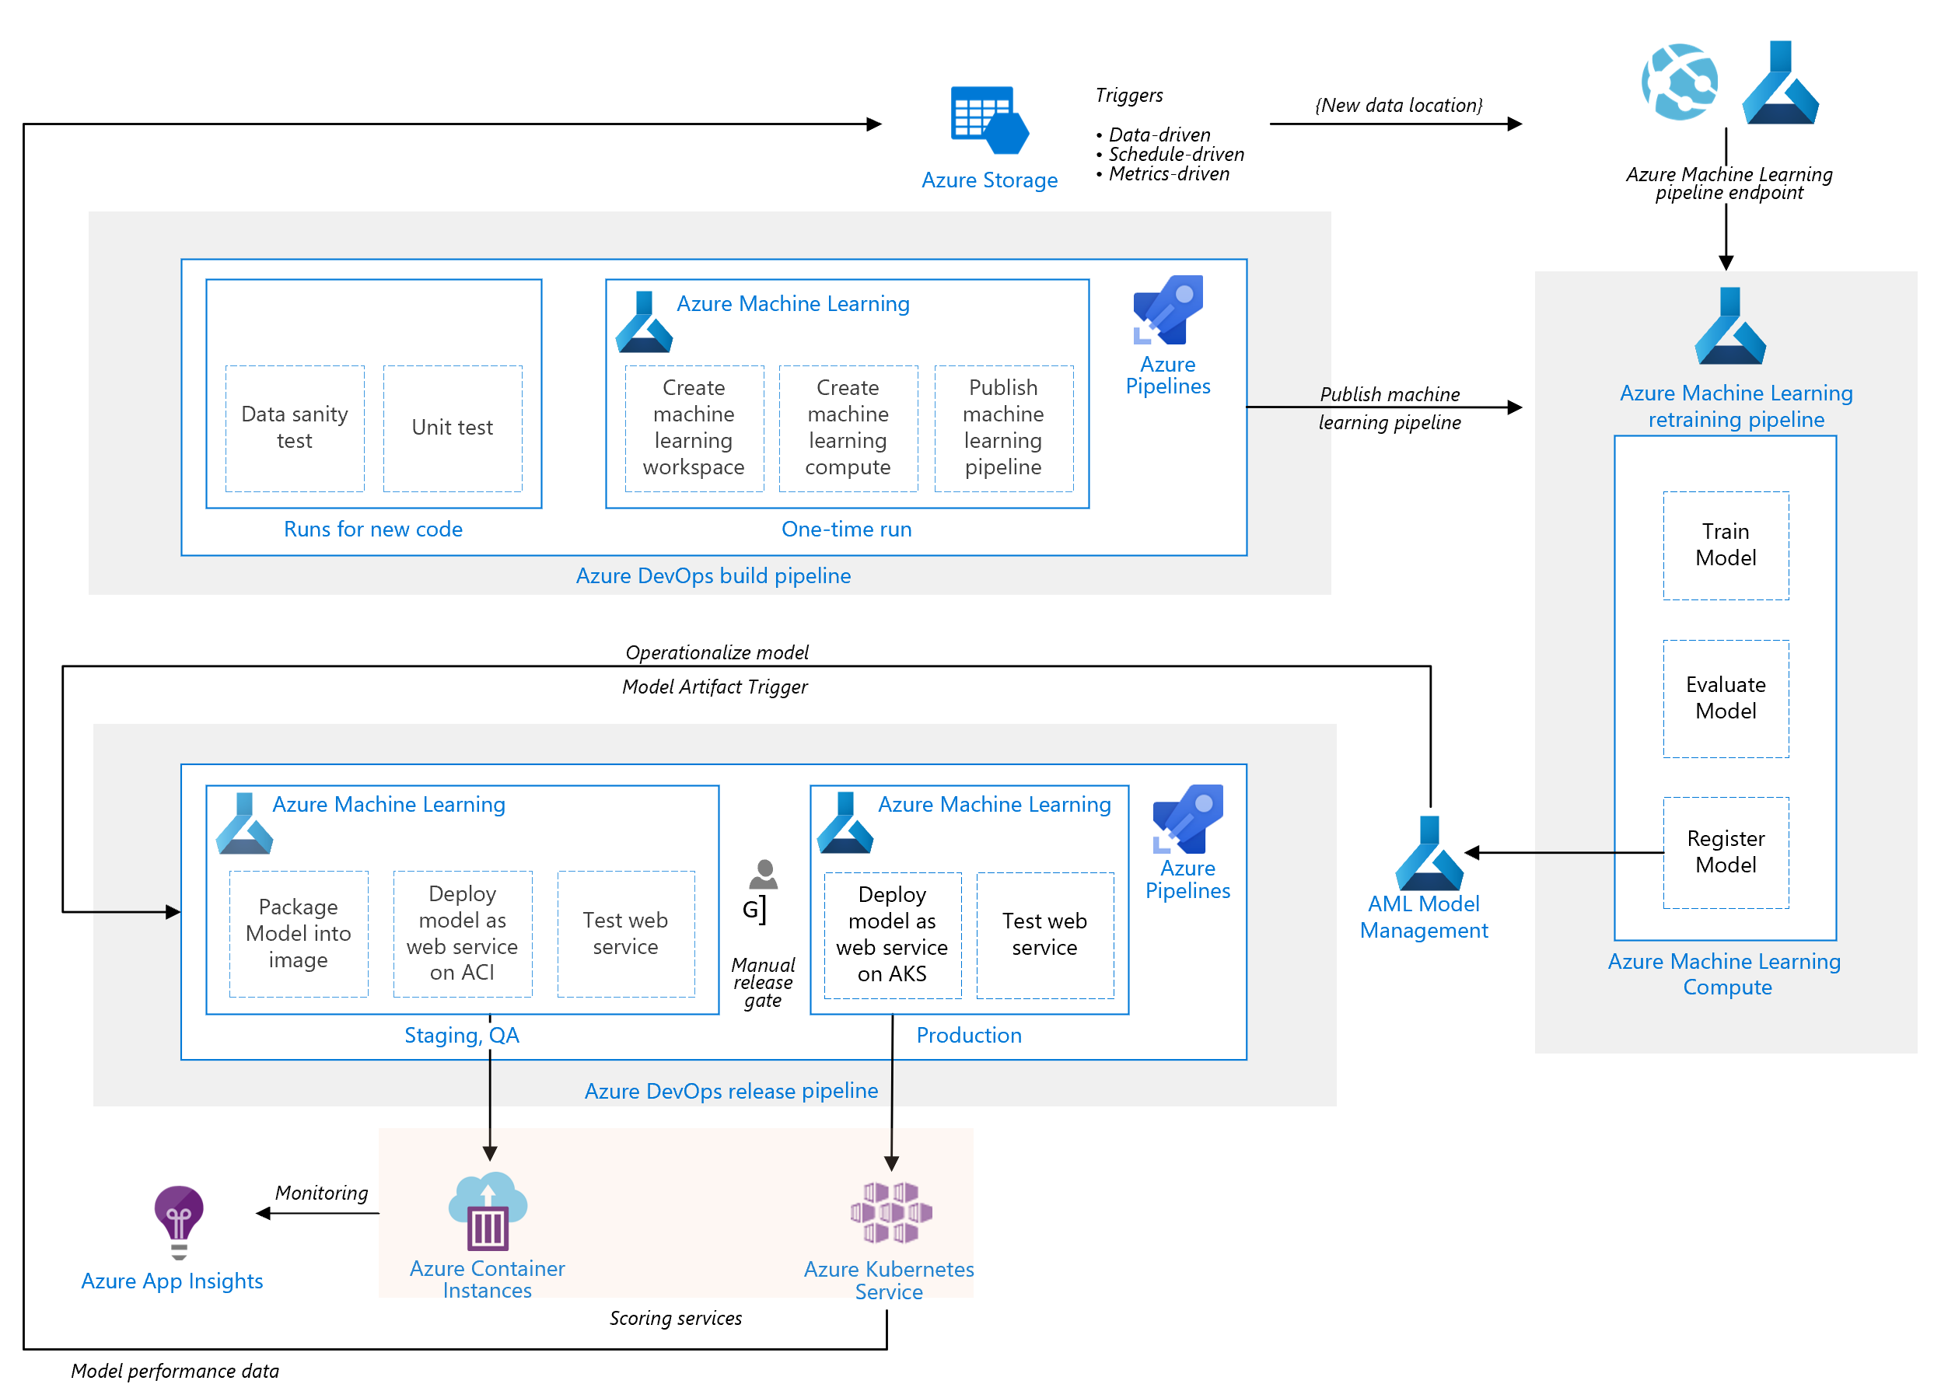
Azure MLOps Reference Architecture

Slide 7

Potential Blockers
Much of these pipelines require AAD owner privileges, especially as we perform ARM template service connections in ADO for both ARM and AML
If you are running the pipeline in a new ADO subscription, or you are operating in the free tier Parallel Job agents have been restricted due to their elicit use, you may need to purchase self-hosted parallel jobs in order to execute the pipelines.
If you have an Azure Policy that restricts the creation of Public IP addresses, then AKS cluster creation will fail. AKS requires a Public IP for egress traffic. The egress traffic article also provides guidance to lock down egress traffic from the cluster through the Public IP, except for a few fully qualified domain names. There are 2 ways to enable a Public IP:
The cluster can use the Public IP created by default with the BLB or SLB, Or
The cluster can be created without a Public IP and then a Public IP is configured with a firewall with a user defined route. For more information, see Customize cluster egress with a user-defined-route.

Slide 8
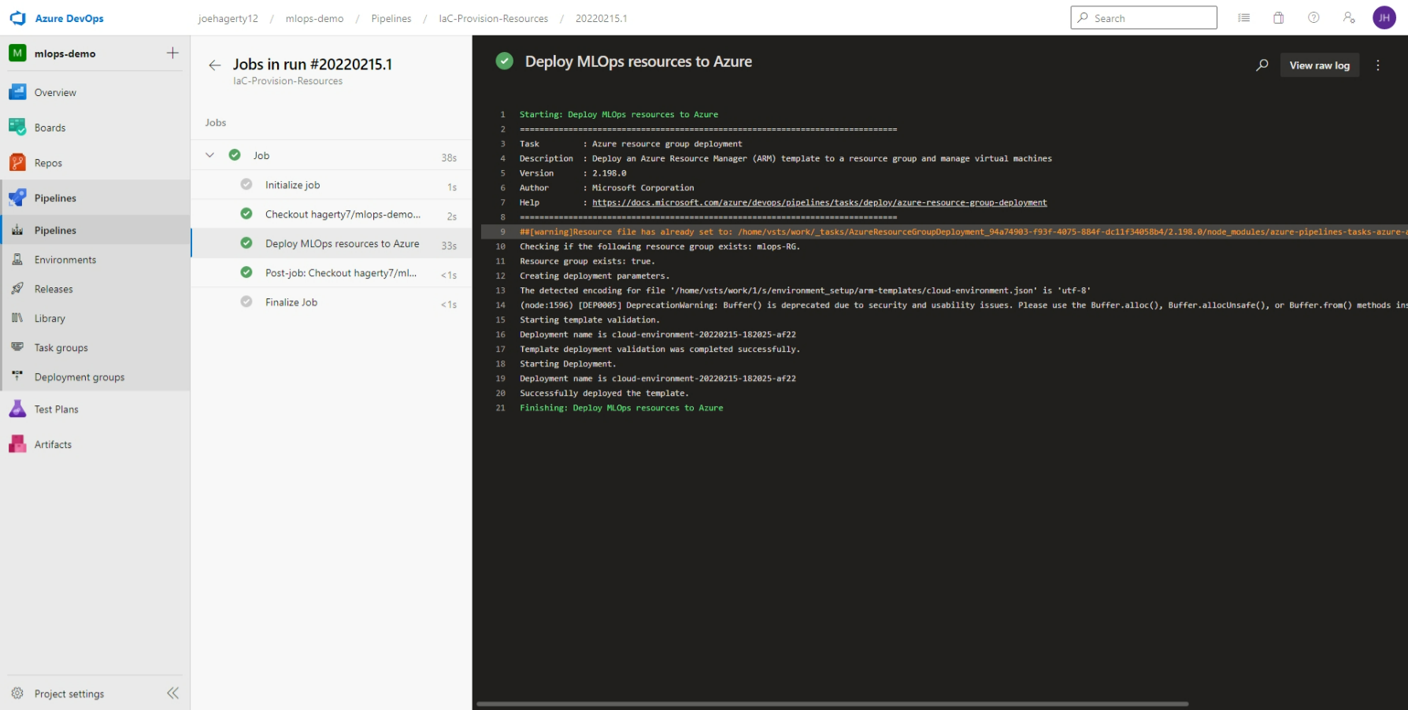
Zooming into the IaC-Provision-Resources pipeline

Slide 9
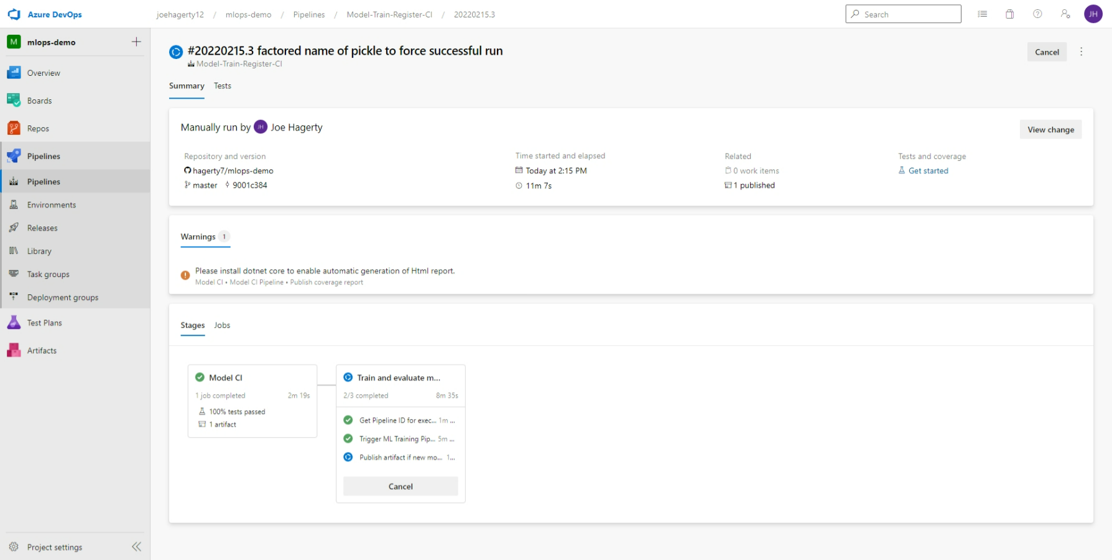
Zooming into the Model-Train-Register-CI Pipeline
Notes:
Stages:
Model CI
Linting (code quality analysis)
Unit tests and code coverage analysis
Build and publish ML Training Pipeline in an ML Workspace
Train model
Determine the ID of the ML Training Pipeline published in the previous stage.
Trigger the ML Training Pipeline and waits for it to complete.
This is an agentless job. The CI pipeline can wait for ML pipeline completion for hours or even days without using agent resources.
Determine if a new model was registered by the ML Training Pipeline.
If the model evaluation step of the AML Pipeline determines that the new model doesn't perform any better than the previous one, the new model won't register and the ML Training Pipeline will be canceled. In this case, you'll see a message in the 'Train Model' job under the 'Determine if evaluation succeeded and new model is registered' step saying 'Model was not registered for this run.’
See evaluate_model.py for the evaluation logic. This is a simplified test that just looks at MSE to decide whether or not to register a new model. A more realistic verification would also do some error analysis and verify the inferences/error distribution against a test dataset, for example.
Note: while it's possible to do an Evaluation Step as part of the ADO pipeline, this evaluation is logically part of the work done by Data Scientists, and as such the recommendation is that this step is done as part of the AML Pipeline and not ADO pipelines.
Additional Variables and Configuration for configuring this and other behavior.
Create pipeline artifact
Get the info about the registered model
Create an Azure DevOps pipeline artifact called model that contains a model.json file containing the model information, for example:

Slide 10
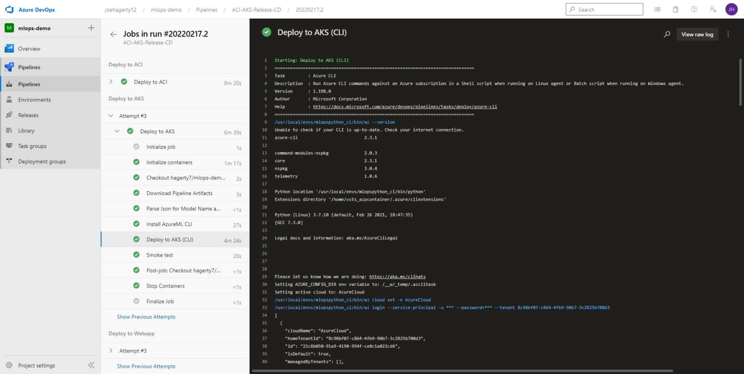
Zooming into the ACI-AKS-Release-CD Pipeline

Slide 11

Other MLOps areas we could showcase as a team
IaC Build Orchestration & Automated Deployments for MLOps:
Deeper into ARM Templates and YAML
Deeper into Versioned Deployments
IaC with Terraform
Triggered Executions (Drift Detected Executions v. Scheduled Executions)
Staged Deployments (Dev-to-Production w/ git)
Dockerized Pipelines
Monitoring solutions (Azure App Insights + Log Analytics vs. Other Options)
Different Training Patterns and Deployment Endpoints for MLOps:
Deeper into ACI endpoints
Deeper in to AKS endpoints
Deploying to an Azure App Service
Deploying to an Azure Function
Deploying to a homegrown Python API (FastAPI or Flask)
Batch Training & Batch Inferencing
Databricks Integrations
MPI and High-Performance Distributed training workloads
SWE Practices for MLOps:
Integrating Code Complexity tests (Radon and Xenon)
Canary testing webservices (AKS)
Deeper into Linting
Deeper into Unit tests
Deeper into Code Coverage
Auto versioning codebase using git tags
Integrating your own ML Libraries (pip or builds)
VSCode + GitHub Setup and running test sequence before ADO + AML from your IDE
SO many more!!!
This Photo by Unknown Author is licensed under CC BY-NC-ND

Slide 12
Appendices

Slide 13
Appendix: Monitoring and Observability ML endpoint performance with App Insights
You can explore aspects of model observability in the solution, such as:
Logging: Navigate to the Application Insights instance linked to the Azure ML Portal, then go to the Logs (Analytics) pane. The following sample query correlates HTTP requests with custom logs generated in score.py. This can be used, for example, to analyze query duration vs. scoring batch size:
let Traceinfo=traces
| extend d=parse_json(tostring(customDimensions.Content))
| project workspace=customDimensions.["Workspace Name"], service=customDimensions.["Service Name"], NumberOfPredictions=tostring(d.NumberOfPredictions), id=tostring(d.RequestId), TraceParent=tostring(d.TraceParent);requests
| project timestamp, id, success, resultCode, duration
| join kind=fullouter Traceinfo on id
| project-away id1
Distributed tracing: The smoke test client code sets an HTTP traceparent header (per the W3C Trace Context proposed specification), and the score.py code logs the header. The query above shows how to surface this value. You can adapt it to your tracing framework.
Monitoring: You can use Azure Monitor for containers to monitor the Azure ML scoring containers' performance.

Slide 14
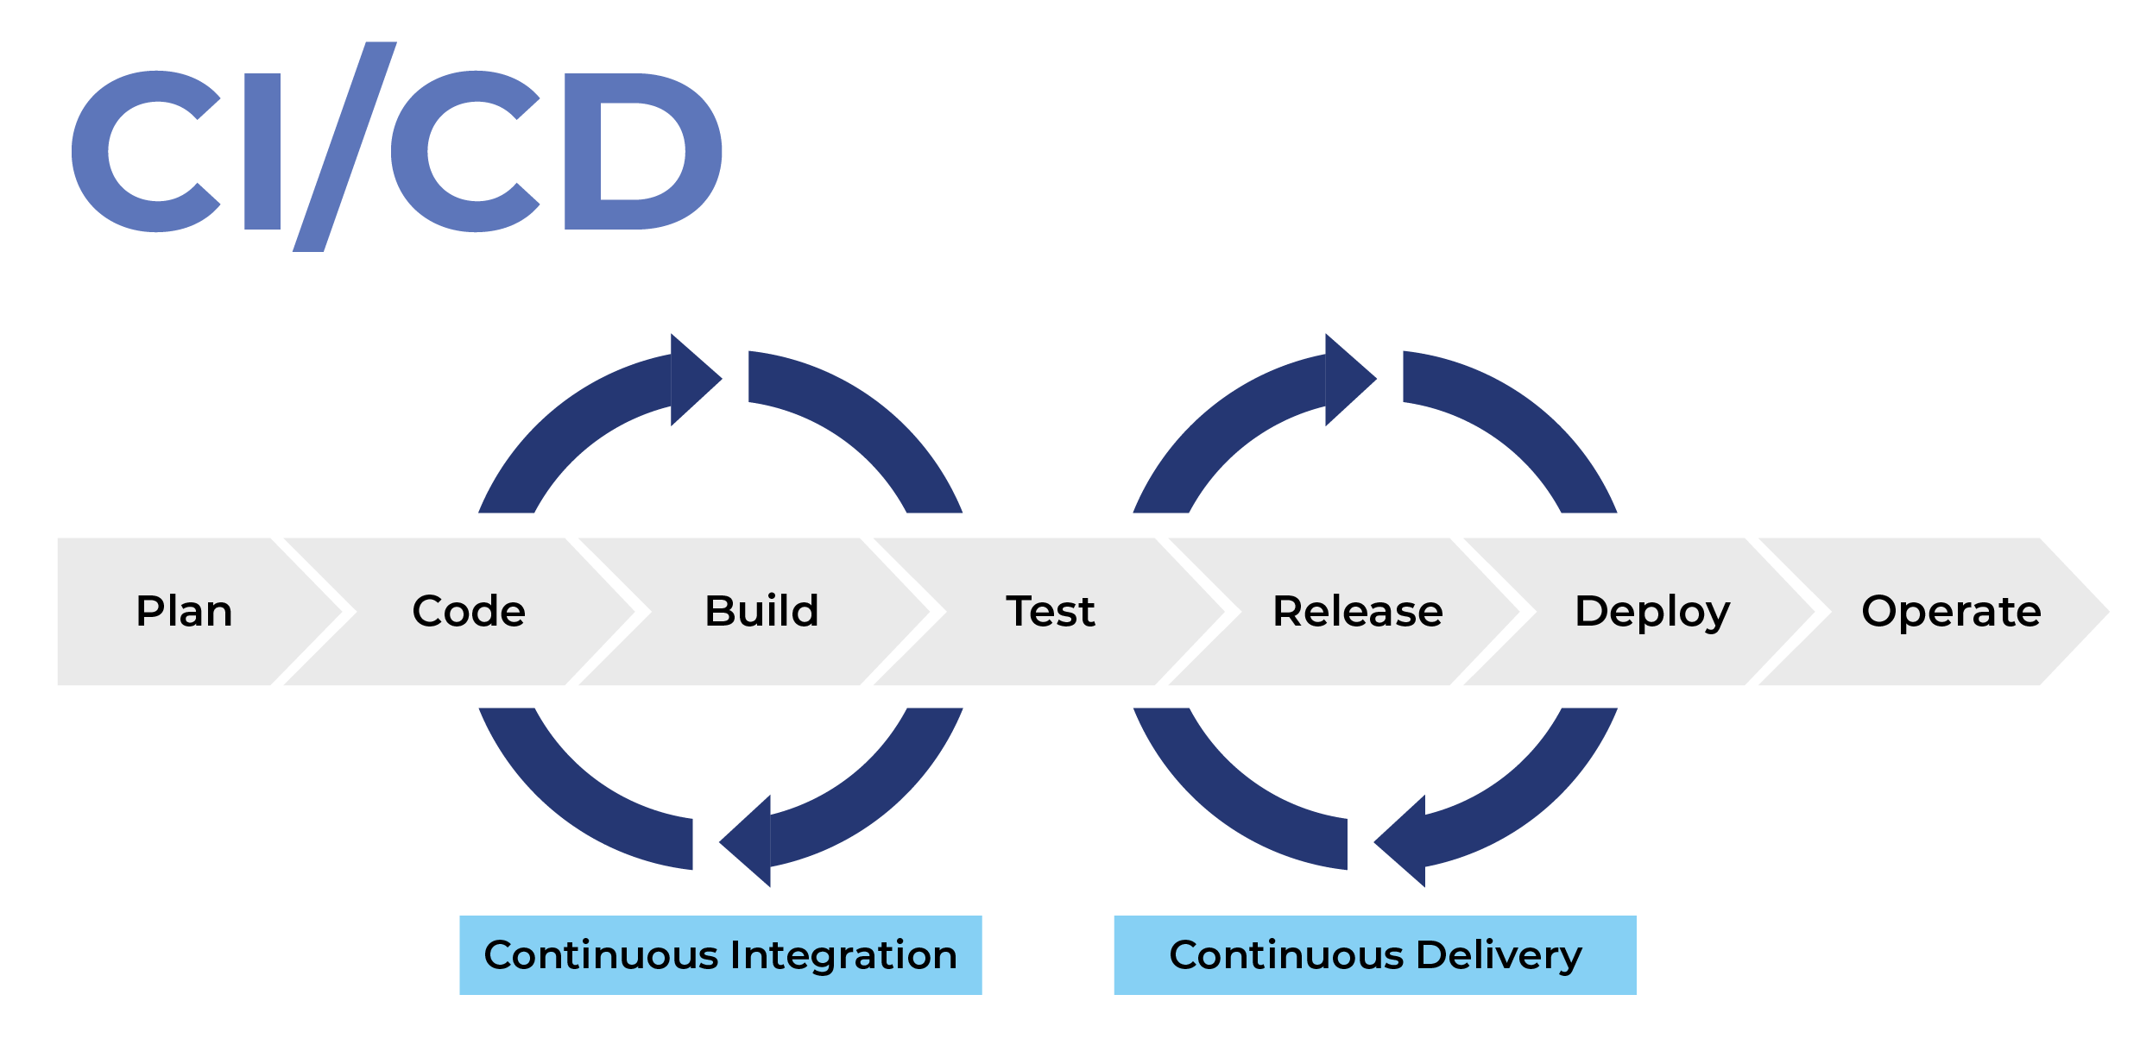
Appendix: What is CI/CD
Automation is a core principle for achieving DevOps and therein MLOps success and CI/CD is a critical component. CI/CD comprises of continuous integration and continuous delivery or continuous deployment. Put together, they form a “CI/CD pipeline”—a series of automated workflows that help DevOps teams cut down on manual tasks, the same principles therein apply to MLOps:
Continuous integration (CI) automatically builds, tests, and integrates code changes within a shared repository; then
Continuous delivery (CD) automatically delivers code changes to production-ready environments for approval; or
Continuous deployment (CD) automatically deploys code changes to customers directly.
This Photo by Unknown Author is licensed under CC BY-SA-NC
Notes:
When someone says CI/CD, the “CD” they’re referring to is usually continuous delivery, not continuous deployment. What’s the difference? In a CI/CD pipeline that uses continuous delivery, automation pauses when developers push to production. A human—your operations, security, or compliance team—still needs to manually sign off before final release, adding more delays. On the other hand, continuous deployment automates the entire release process. Code changes are deployed to customers as soon as they pass all the required tests.
Continuous deployment is the ultimate example of DevOps automation. That doesn’t mean it’s the only way to do CI/CD, or the “right” way. Since continuous deployment relies on rigorous testing tools and a mature testing culture, most software teams start with continuous delivery and integrate more automated testing over time.

Slide 15
Appendix: What is Linting
lint, or a linter, is a tool that analyzes source code to flag programming errors, bugs, stylistic errors, and suspicious constructs.
My go to in python is Flake8 but there are many others to choose from as integration points in VScode
Linter | Package name for pip install command | True/false enable setting (python.linting.) | Arguments setting (python.linting.) | Custom path setting (python.linting.)
Pylint | pylint | pylintEnabled | pylintArgs | pylintPath
Flake8 | flake8 | flake8Enabled | flake8Args | flake8Path
mypy | mypy | mypyEnabled | mypyArgs | mypyPath
pycodestyle (pep8) | pycodestyle | pycodestyleEnabled | pycodestyleArgs | pycodestylePath
prospector | prospector | prospectorEnabled | prospectorArgs | prospectorPath
pylama | pylama | pylamaEnabled | pylamaArgs | pylamaPath
bandit | bandit | banditEnabled | banditArgs | banditPath

Slide 16

Appendix: Why Lint your ML stuff
What can linting be useful for MLOps?
Flagging bugs in your code from syntax errors
Giving you warnings when code may not be intuitive
Providing suggestions for common best practices
Keeping track of TODO’s and FIXME’s
Keeping a consistent code style
Ensure that downstream deployment stages are isolated from code errors
This Photo by Unknown Author is licensed under CC BY

Slide 17

Appendix: What is Code Coverage
Code coverage is a measure (in percent) of the degree to which the source code of a program is executed when a test suite is run. A program with high test coverage has more of its source code executed during testing, which suggests it has a lower chance of containing undetected software bugs compared to a program with low test coverage. Many different metrics can be used to calculate test coverage.
Coverage.py is an accessible module to run your coverage assessment to assess how much of functional and/or OOP code in python is covered by tests 100 percent is always the goal!

Slide 18
Appendix: Creating AML AKS k8 using the AML SDK or using az ml
from azureml.core.compute import AksCompute, ComputeTarget
# Use the default configuration (you can also provide parameters to customize this).
# For example, to create a dev/test cluster, use:
# prov_config = AksCompute.provisioning_configuration(cluster_purpose =
# AksCompute.ClusterPurpose.DEV_TEST)
prov_config = AksCompute.provisioning_configuration()
# Example configuration to use an existing virtual network
# prov_config.vnet_name = "mynetwork"
# prov_config.vnet_resourcegroup_name = "mygroup"
# prov_config.subnet_name = "default"
# prov_config.service_cidr = "10.0.0.0/16"
# prov_config.dns_service_ip = "10.0.0.10"
# prov_config.docker_bridge_cidr = "172.17.0.1/16"
aks_name = ‘aks'
# Create the cluster
aks_target = ComputeTarget.create(workspace = ws,
name = aks_name,
provisioning_configuration = prov_config)
# Wait for the create process to complete
aks_target.wait_for_completion(show_output = True)
> az ml computetarget create amlcompute --max-nodes
--name
--vm-size
[--admin-user-password]
[--admin-user-ssh-key]
[--admin-username]
[--assign-identity]
[--description]
[--enable-node-public-ip]
[--idle-seconds-before-scaledown]
[--location]
[--min-nodes]
[--no-wait]
[--path]
[--remote-login-port-public-access]
[--resource-group]
[--subnet-name]
[--subscription-id]
[--tag]
[--vm-priority]
[--vnet-name]
[--vnet-resourcegroup-name]
[--workspace-name]
[-v]

Slide 19
Appendix: Attaching Existing AML AKS k8 using the AML SDK or using az ml
from azureml.core.compute import AksCompute, ComputeTarget
# Set the resource group that contains the AKS cluster and the cluster name
resource_group = 'myresourcegroup'
cluster_name = 'myexistingcluster'
# Attach the cluster to your workgroup. If the cluster has less than 12 virtual CPUs, use the following instead:
# attach_config = AksCompute.attach_configuration(resource_group = resource_group,
# cluster_name = cluster_name,
# cluster_purpose = AksCompute.ClusterPurpose.DEV_TEST)
attach_config = AksCompute.attach_configuration(resource_group = resource_group,
cluster_name = cluster_name)
aks_target = ComputeTarget.attach(ws, 'aks', attach_config)
# Wait for the attach process to complete
aks_target.wait_for_completion(show_output = True)
> az aks show -n myexistingcluster -g myresourcegroup --query id

Slide 20
Appendix: AML AKS ARM Template
from azureml.core.compute import AksCompute, ComputeTarget
# Set the resource group that contains the AKS cluster and the cluster name
resource_group = 'myresourcegroup'
cluster_name = 'myexistingcluster'
# Attach the cluster to your workgroup. If the cluster has less than 12 virtual CPUs, use the following instead:
# attach_config = AksCompute.attach_configuration(resource_group = resource_group,
# cluster_name = cluster_name,
# cluster_purpose = AksCompute.ClusterPurpose.DEV_TEST)
attach_config = AksCompute.attach_configuration(resource_group = resource_group,
cluster_name = cluster_name)
aks_target = ComputeTarget.attach(ws, 'aks', attach_config)
# Wait for the attach process to complete
aks_target.wait_for_completion(show_output = True)
> az aks show -n myexistingcluster -g myresourcegroup --query id

Slide 21
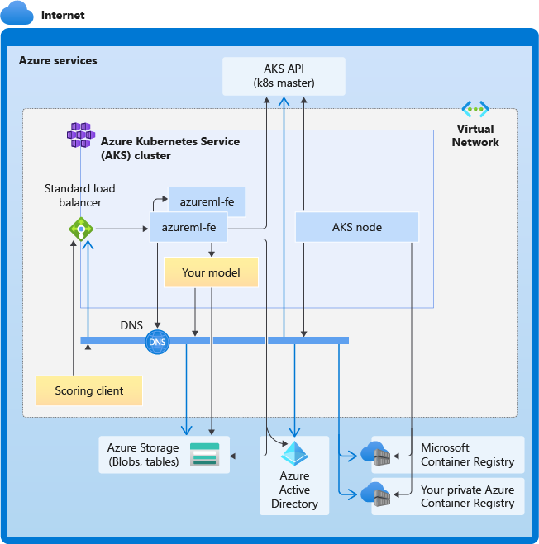
Appendix: AKS Networking

